Slide 1



Covid 19 – Analysis for Canada

Slide 2
Methodology/Highlights
Infection rates by age & gender across all provinces
Vaccination rates per province & the total population vaccinated
Covid-19 Confirmed cases per day by province over time
Covid-19 Cumulative active cases per day by province over time
Covid-19 Mortality rate per province over time (death)
Covid-19 Hospitalization rates across all provinces
Time Frame covered: Start of pandemic in January 2020 up to end of March 2023

Slide 3
Data Sources:
± URL: https://www150.statcan.gc.ca/n1/tbl/csv/13100809-eng.zip
± API: https://api.opencovid.ca/ : an open source API
± https://github.com/ccodwg/CovidTimelineCanada: Github repository related to API
± https://open.canada.ca/data/dataset/ab5f4a2b-7219-4dc7-9e4d-aa4036c5bf36
± https://open.canada.ca/data/dataset/752ce2b7-c15a-4965-a3dc-397bf405e7cc

Slide 4
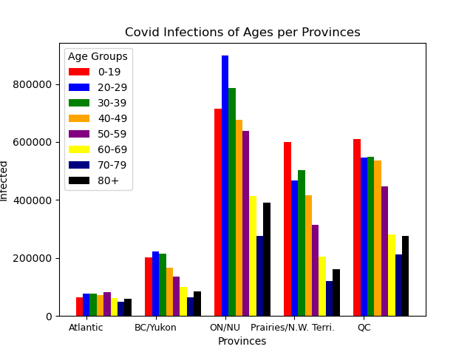
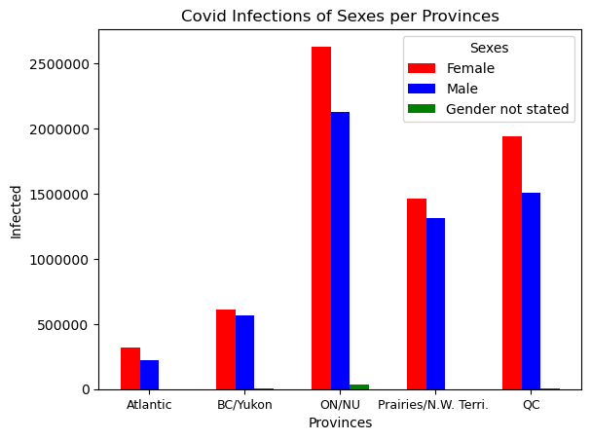
Infections by Age & Gender
Ontario has the highest number on infection amongst all provinces throughout the entire period.
Age group 20-29 were the most infected followed by 30-39 and then 40-49
Females were most infected across all provinces and again ON containing the highest number of infection

Slide 5
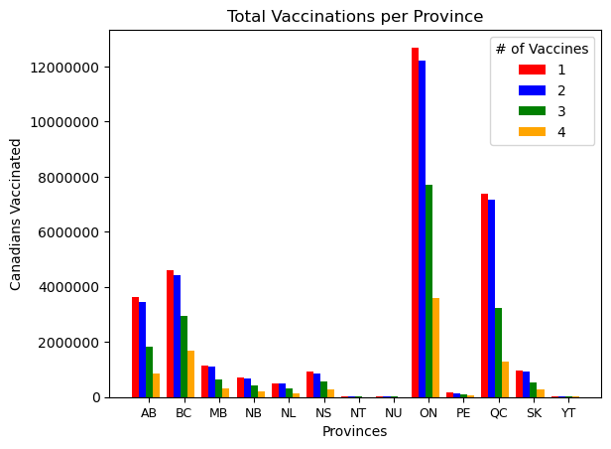
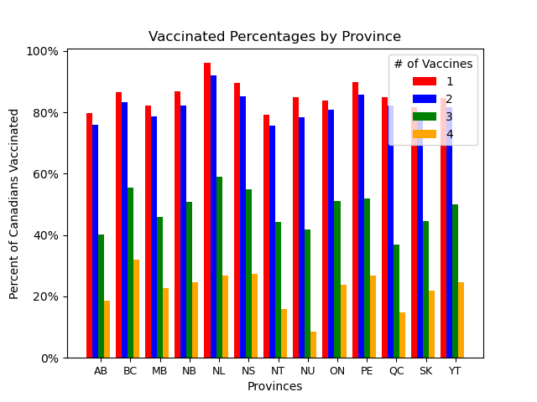
Vaccinations per Province
Clearly a large number of Canadians were vaccinated for the first dose, which slowly gets less and less for each consecutive dose, except for certain provinces which seem to have very little.
Some populations are very small to begin with, and when we look at it percentage wise, in fact nearly all provinces have an above 90% vaccination rate for the first dose, which does again, peter out for consecutive doses.
In contrast we have ON which has the highest number of citizens vaccination, since ON has the largest and densest population of the provinces.

Slide 6
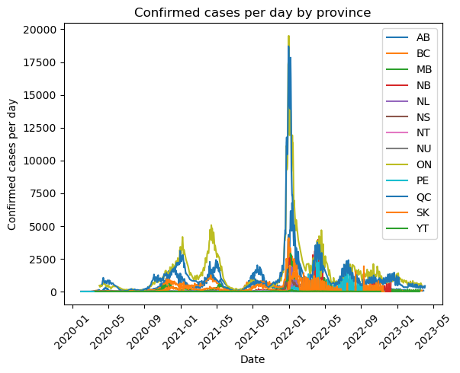
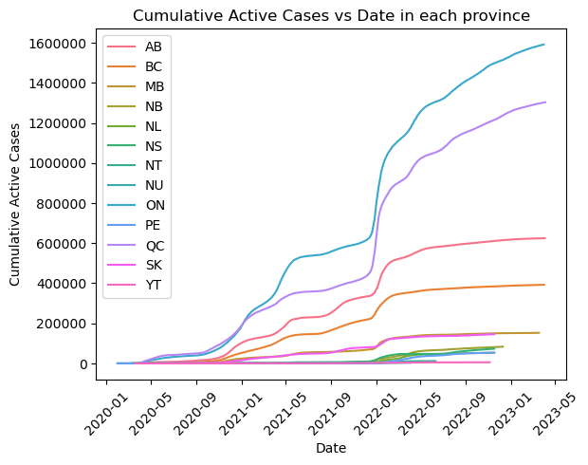
COVID-19 trend
ON
ON
QC
AB
Assumptions made to calculate active cases: As recovered data/cured data was not available in the API, we used the cumulative hospitalizations cases instead of recovered data to calculate the cumulative active cases
Cumulative cases in Ontario(ON) are the highest and reached a peak on January 2022 in daily cases
However, after the major peak there is a significant drop in active cases/day for all provinces
Notes:
The population size of Ontario is among the highest in Canada and this could be one of the reasons. Although the numbers are rising for each province it has plateaued for most provinces, Ontario and Quebec are leading but even for them it seems to have reached a plateau.

Slide 7
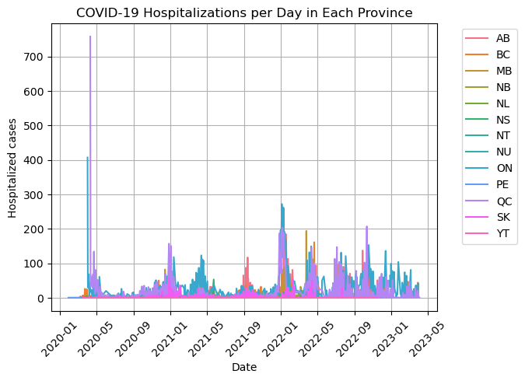
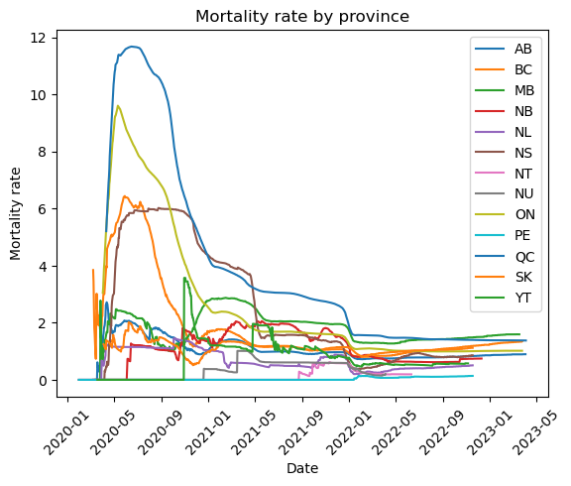
Hospitalization/Day and Mortality Rate Over Time
QC
QC
Hospitalizations/day decrease over time for all provinces with occasional smaller spikes
Mortality Rate over time also significantly decreased over time for all provinces

Slide 8
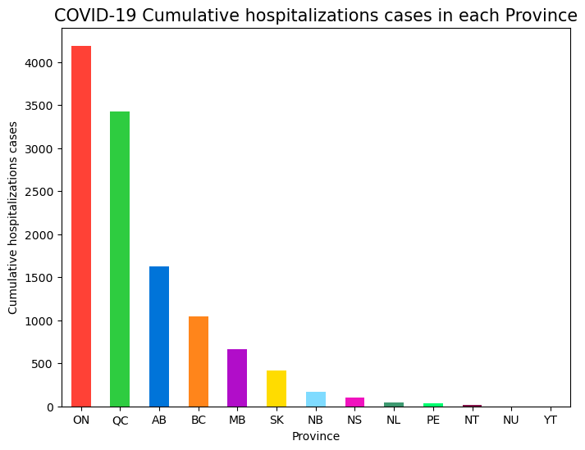
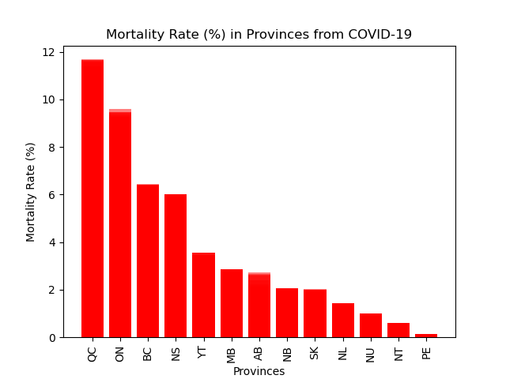
Hospitalization cases and Mortality Rate
Ontario has the highest cumulative hospitalization cases across Canada, having second highest mortality rate
Quebec presents the highest mortality rate at almost 12%
Notes:
Based on our findings we can see that Ontario has the highest hospitalization cases across Canada followed by Quebec. This could be because Ontario has one the highest population in Canada, hence more people were seen in hospitals. Furthermore, vaccines became available after the start of the pandemic so there wasn’t much protection at first, coupled with vaccine hesitancy for some time.
The graph above depicts mortality rate (%) in each province. The highest mortality rate was observed in Quebec followed by ON between Jan-2020 and March-2023.
Even though ON leads in the number of cumulative cases, QC comes first in mortality rate. This could be related to the ease of access to medical support in each province. Population size, availability of hospital beds per capita

Slide 9
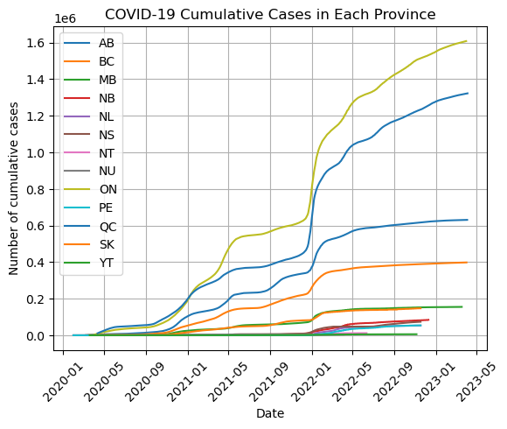
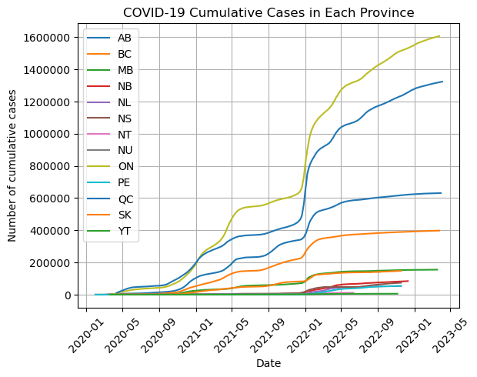

Interesting findings
Fixing the y-scale exponential values to linear on the line-plot
VS.
In order to fix the exponential values in the yscale performed:
To further fix the y-scale, used:
Notes:
As we were plotting the graphs, we encountered a few interesting codes to make quick changes here and there. Like the first, one is using the ticker library from matplotlib to change exponential numbers to their linear format. It couldn’t be done with just plt.yscale(‘linear’)

Slide 10
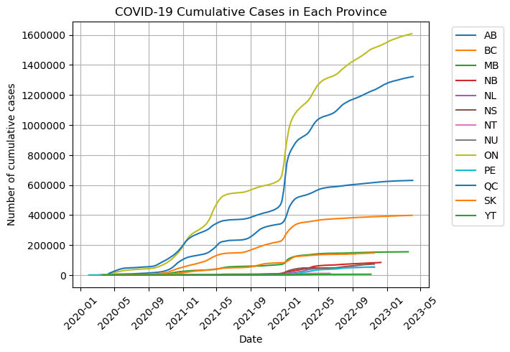
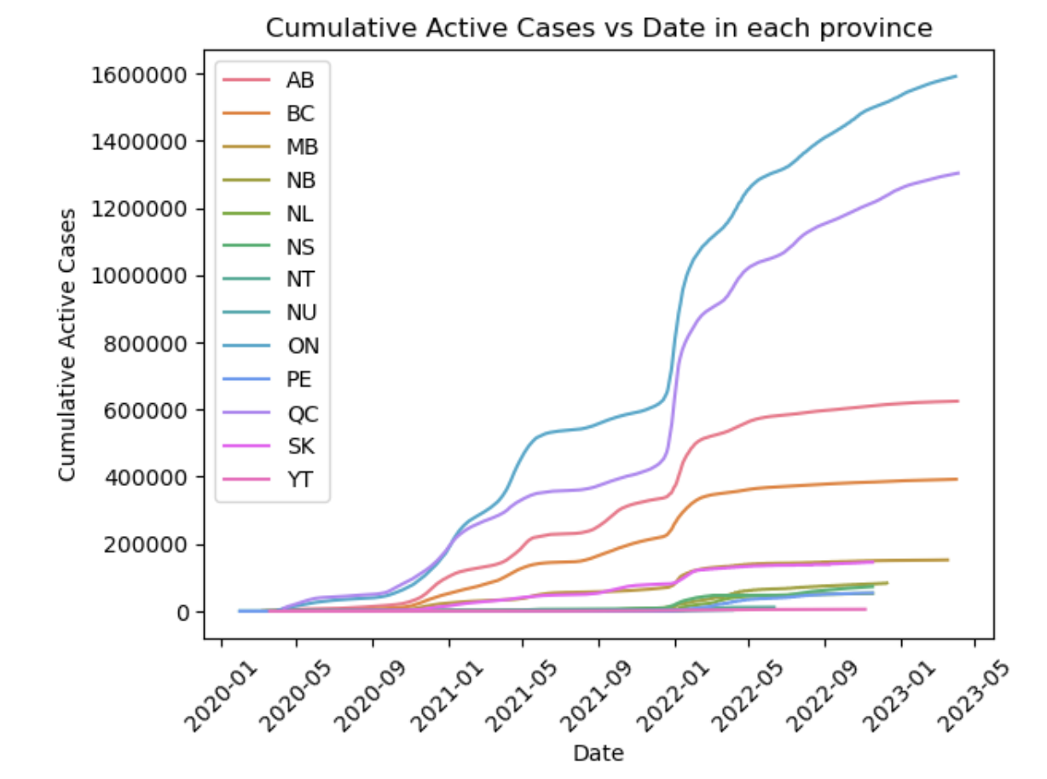

Interesting findings
Legend adjustment:
Seaborn library - distinct colours for each province
Notes:
Sometimes the legend obscured the view of visualizations and key findings, so we found a way to adjust the legend to prevent this issue, not only with loc but also bbox to anchor.
The seaborn library allowed us to draw a lineplot and use ‘hue’, one of its parameters that helps interpret data with different colours.
When bbox_to_anchor and loc are used together, the loc argument will inform matplotlib which part of the bounding box of the legend should be placed at the arguments of bbox_to_anchor.

Slide 11
Implications
Infections of both young and old age groups shows that they are more at risk than others, even with a potentially smaller population in the group.
With such a high percentage of initial vaccinations, we can make the assumption that this has contributed to the decrease of active cases. There has also been a lack of interest as time goes on to get more vaccinations.
High hospitalization cases are associated with high mortality rate in Quebec and Ontario
Population size?
Vaccine controversy?
Risk factors that increase vulnerability?
Access to medical personnel in timely manner
According to the Govt. of Canada website, the first COVID-vaccine was administered on December 14, 2020
Supports our inference of drop in cases
Citations
-Canada, P. H. A. of. (2021, April 16). Updates: COVID-19 vaccine doses administered in Canada. Canada.ca. Retrieved April 12, 2023, from https://health-infobase.canada.ca/covid-19/vaccine-administration/
Notes:
Although we may not have a linear regression to show everyone how vaccination doses led to a decrease in the main covid metrics we studied. We can make an inference about these two variables.

Slide 12
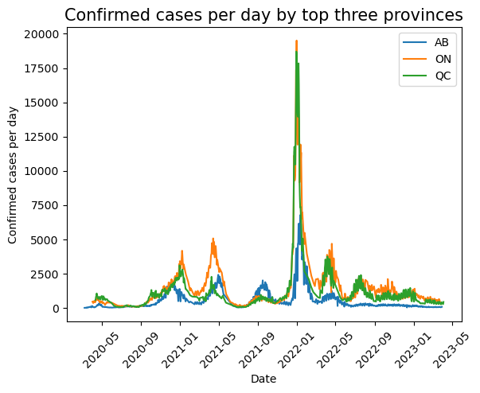

Slide 13
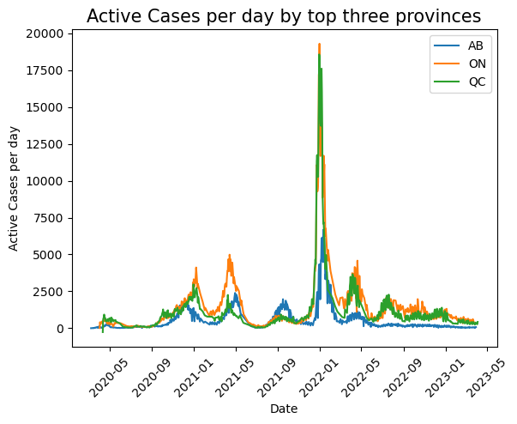
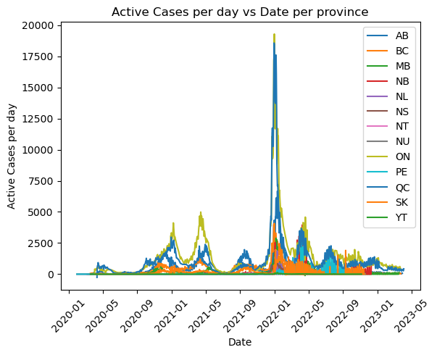

Slide 14
